Slide 1
Advanced Testing
Techniques to testing code

Slide 2
Overview
Control flow graphs
Unit Testing Revisited
Testing Concept questions
WhiteBox Testing
Worked example

Slide 3
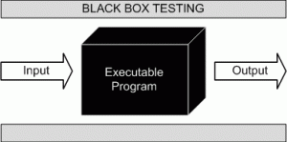

BlackBox vs WhiteBox

Slide 4
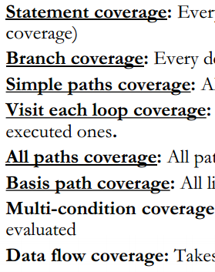
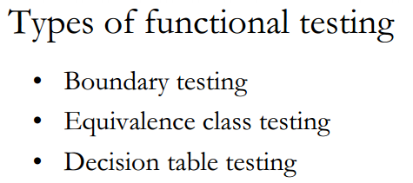
BlackBox vs WhiteBox

Slide 5
Triangle Example Revisited
A programmer wrote the following function for a math library. Come up with some functional test cases for the function defined below. Hint: there can be up to 21

Slide 6
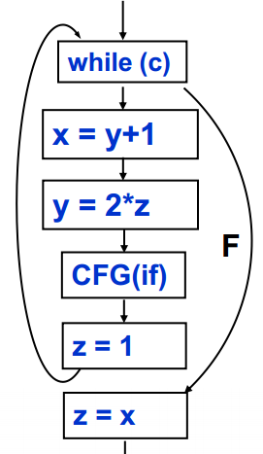
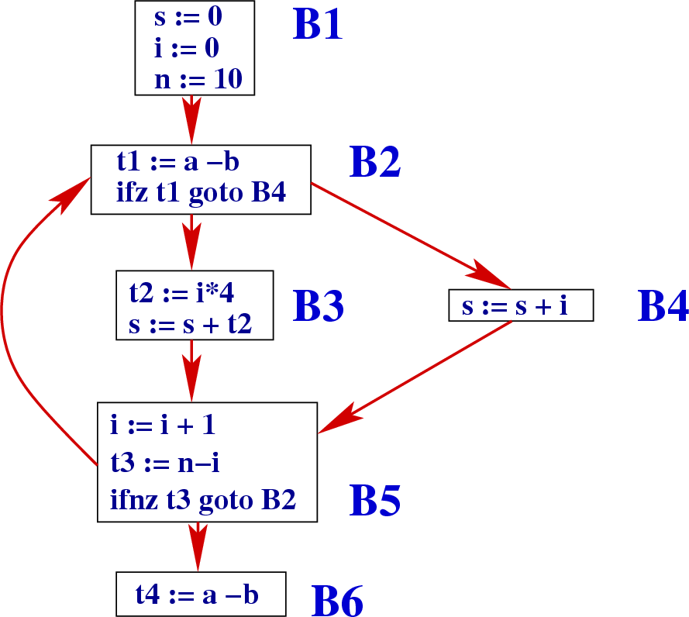
Control Flow Graphs

Slide 7
Triangle Exercise
Given the follow control flow graph find the paths if you were asked to test for:
Simple Path Coverage
Statement Coverage
Branch Coverage
Basis Path coverage
.
No Node appears more than once (ie. No loops)
Every statement is executed once
Every branch is taken
Every possible path is covered once

Slide 8
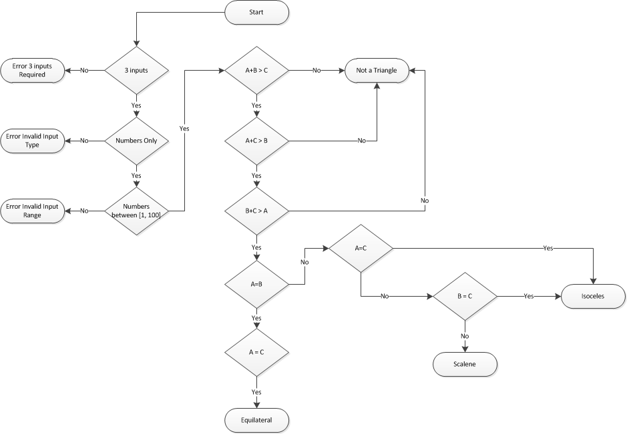
Triangle Exercise
Given the follow control flow graph find the number of paths if you were asked to test for:
Simple Path Coverage
Statement Coverage
Branch Coverage
Basis Path coverage
.

Slide 9
Triangle Exercise
NOTE:You are only responsible for Control Flow graphs and not Flow Charts such as this one
Given the follow control flow graph find the number of paths if you were asked to test for:
Simple Path Coverage
Statement Coverage
Branch Coverage
Basis Path coverage
.
10
7
10
10

Slide 10
Concept questions
You work for a company that sells a desktop app that millions of customers use. 10% of your customer base complains that the app crashes every Tuesday morning. How do you start your investigation?

Slide 11
Concept questions
You are writing a java program and notice a bug. You put a print statement in your code to diagnose the bug. The bug disappeared. What could have happened

Slide 12
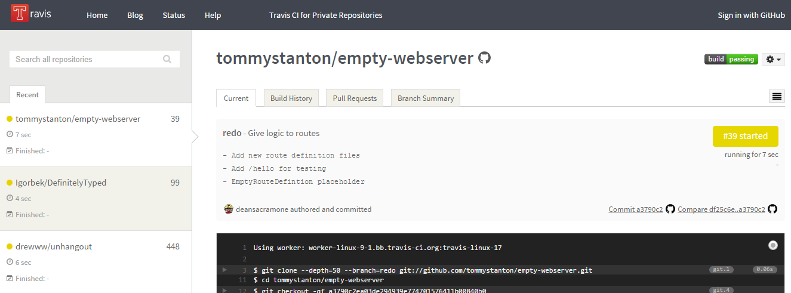
Continuous Integration with Travis

Slide 13
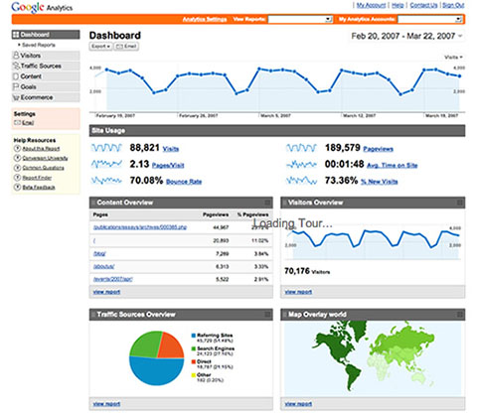

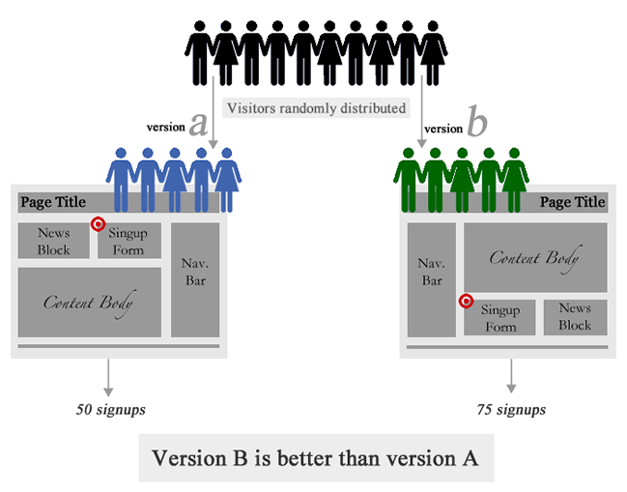

Alternative Testing Methods

Slide 14
References
http://www.vogella.com/tutorials/JUnit/article.html
http://docs.travis-ci.com/user/getting-started/
Basis path: http://users.csc.calpoly.edu/~jdalbey/206/Lectures/basispathEg.html

